Slide 1
MOVIE RECOMMENDATION SYSTEM
Group 9: Jiachen Yu, Namra Naseem, Sunny Xiang, Zhi Zhang

Slide 2
Table of contents
01
02
03
04
05
Business Problem
Solution Proposal
Technical Implement
Overall Learning
Live Demo

Slide 3
Business Problem
01
Identification and Justification

Slide 4
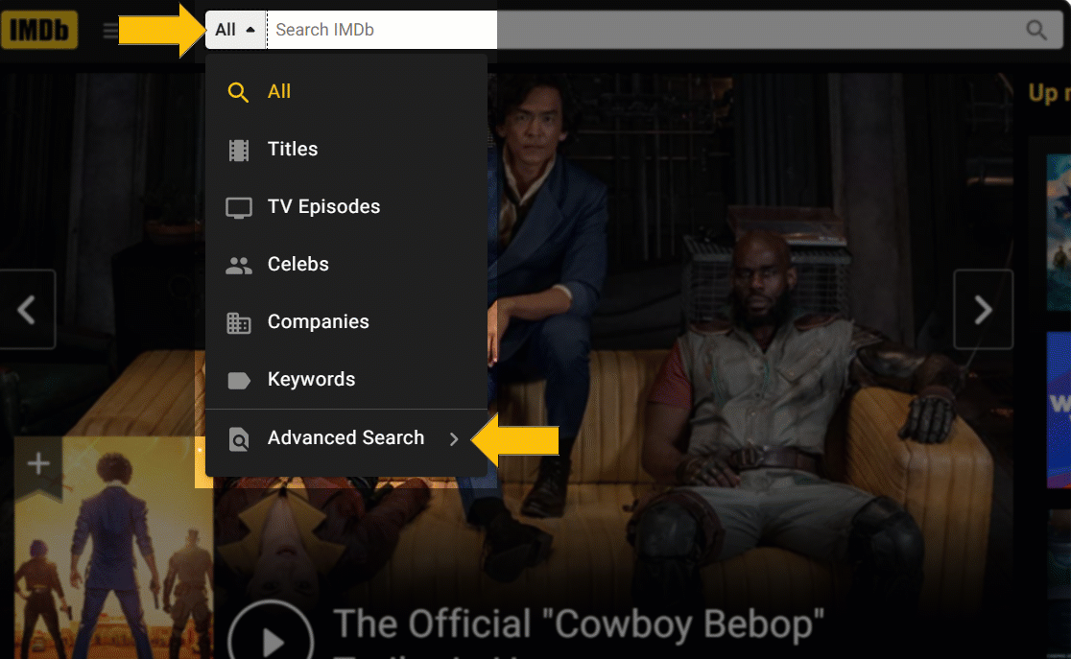
Business Problem
"Traditional movie recommendation systems, even with advanced search features, fail to capture users' deeper emotional preferences, creating an opportunity to enhance personalization by leveraging sentiment and nuanced factors from reviews."
Notes:
"In today's world, movie recommendation systems are widely used by streaming platforms to enhance user engagement. While some platforms offer advanced search features, such as filtering by genre, actors, or release dates, these options still fall short in fully capturing the deeper preferences and emotions of users. They typically rely on factors like ratings, past behavior, or genre, but often miss the more nuanced reasons why someone enjoys a particular movie, such as its emotional tone, character depth, or personal impact.
The challenge is that even with advanced search options, traditional systems fail to leverage the rich sentiment and emotional expressions found in user reviews, leading to impersonal or mismatched recommendations. This gap presents a key opportunity to significantly enhance personalization, leading to more relevant suggestions and higher user satisfaction."
For instance, someone might love a particular movie not just because of its genre, but because of its emotional tone, the depth of its characters, or the way it made them feel. Advanced searches based on technical attributes don't consider these subtle emotional or experiential factors.

Slide 5
02
Solution Proposal

Slide 6
Our Proposed Solution…
"Use an advanced recommendation system powered by NLP and machine learning, built on the RAG framework. It goes beyond traditional approaches by combining keyword matching, semantic search, and sentiment analysis."
Notes:
“Our proposed solution to this problem is to use an advanced recommendation system powered by Natural Language Processing (NLP) and machine learning, built on the Retrieval-Augmented Generation (RAG) framework. Our system goes beyond the traditional recommendation approaches by combining keyword matching with semantic search and sentiment analysis.”

Slide 7
Steps to Build the
Recommendation System
Start by fine-tuning a pretrained Sentence Transformer model to better capture the nuances in movie descriptions and user reviews.
Create a search engine using BM25 and vector embeddings, allowing for efficient Retrieval-Augmented Generation (RAG) based on user queries.
Use the OpenAI API to generate personalized responses, enhancing recommendations based on the user's input and search results.

Slide 8
03
Technical Implementation

Slide 9
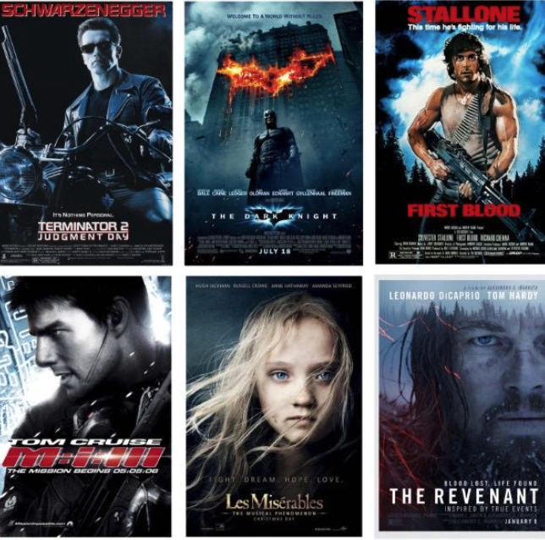
TMDB
5000 Movie Dataset
The dataset is from Kaggle and contains metadata about movies from The Movie Database (TMDb).
Includes 5,000 movies with various metadata fields, offering comprehensive details for each film.

Slide 10
Data Preparation
Text Processing and Combining Features: :
Extracted and cleaned 12 meaningful variable columns to make the text more structured
Merging all relevant info from the columns into one combined field
Comprehensive column allows model to learn the semantic meaning of each movie by leveraging multiple aspects of movie information

Slide 11
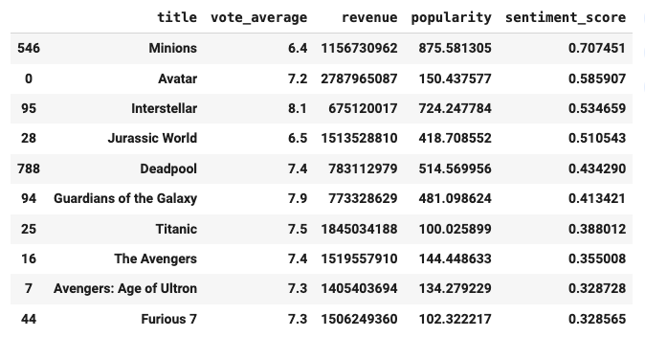
Sentiment Score
Proxy Measures: used revenue and popularity as proxies for sentiment, normalizing both variables for consistency.
Score Calculation: computed by equally weighting revenue and popularity.
Purpose: This approach provides a measure of commercial success, helping recommend popular or high-performing movies.

Slide 12
What do we do in the Fine-Tuning?
Fine-Tuning
Improving Basic Model
Training Prep
Implementing Cosine Similarity Loss Function to understand nuanced differences in movie content
Even if two movies are in the same genre, if their plots are very different, the model may see them as dissimilar.
Loading Pre-trained Basic Sentence Transformer Model
Train to understand semantic similarity based on the combined text descriptions of movies
Creating 1000 pairs of similar and dissimilar movies using Genre for grouping
Teach the model to enhance its relevance in recommendations
Notes:
The goal was to tailor the model specifically for recommending movies based on user queries and improve the relevance of the recommendations.
We grouped the combined description column of each movie by genre and created 1000 similar and dissimilar pairs of movies.
After fine-tuning, the model became better at understanding the semantic meaning of movie descriptions rather than just relying on genres.

Slide 13

Enhancing Movie Recommendations
Process
Benefits
FAISS Similarity Index
Numerical Embeddings
FAISS indexing for quick searches
Speed
Accuracy
Scalability

Slide 14
Enhancing Movie Recommendations
Process
Benefits
FAISS Similarity Index
Numerical Embeddings
FAISS indexing through Euclidean distance
Speed
Accuracy
Scalability
Notes:
Our project had several key takeaways that were crucial to its success:
Model Tuning: We focused on fine-tuning the sentence transformer to better capture semantic similarities between movies, which improved recommendation accuracy.
Ranking Optimization: By optimizing ranking algorithms, like BM25 and cosine similarity, we ensured the most relevant movies were prioritized.
API Integration: Leveraging OpenAI's API allowed us to generate personalized movie suggestions that felt conversational and engaging.
Iterative Testing: Finally, through continuous testing and iteration, we refined our system for both performance and responsiveness.

Slide 15
Enhancing Movie Recommendations
Combining Scores for Better Recommendations
BM25 Score
Understanding the relevance of the text content
Cosine Similarity
Ranking movies with similar overall content higher
Rating
Prioritizing movies that are well-rated by users
Sentiment Score
Recommending popular or high performing movies
Notes:
Our project had several key takeaways that were crucial to its success:
Model Tuning: We focused on fine-tuning the sentence transformer to better capture semantic similarities between movies, which improved recommendation accuracy.
Ranking Optimization: By optimizing ranking algorithms, like BM25 and cosine similarity, we ensured the most relevant movies were prioritized.
API Integration: Leveraging OpenAI's API allowed us to generate personalized movie suggestions that felt conversational and engaging.
Iterative Testing: Finally, through continuous testing and iteration, we refined our system for both performance and responsiveness.

Slide 16
Enhancing Movie Recommendations
Combining Scores for Better Recommendations
BM25 Score
Understanding the relevance of the text content
Cosine Similarity
Ranking movies with similar overall content higher
Rating
Prioritizing movies that are well-rated by users
Sentiment Score
Recommending popular or high performing movies
Notes:
Our project had several key takeaways that were crucial to its success:
Model Tuning: We focused on fine-tuning the sentence transformer to better capture semantic similarities between movies, which improved recommendation accuracy.
Ranking Optimization: By optimizing ranking algorithms, like BM25 and cosine similarity, we ensured the most relevant movies were prioritized.
API Integration: Leveraging OpenAI's API allowed us to generate personalized movie suggestions that felt conversational and engaging.
Iterative Testing: Finally, through continuous testing and iteration, we refined our system for both performance and responsiveness.

Slide 17
Enhancing Movie Recommendations
Combining Scores for Better Recommendations
BM25 Score
Understanding the relevance of the text content
Cosine Similarity
Ranking movies with similar overall content higher
Rating
Prioritizing movies that are well-rated by users
Sentiment Score
Recommending popular or high performing movies

Slide 18
04
Overall Learning
& Next Steps

Slide 19
Key Takeaways
API
Integration
Model
Tuning
Ranking
Optimization
Iterative
Testing
Notes:
Our project had several key takeaways that were crucial to its success:
Model Tuning: We focused on fine-tuning the sentence transformer to better capture semantic similarities between movies, which improved recommendation accuracy.
Ranking Optimization: By optimizing ranking algorithms, like BM25 and cosine similarity, we ensured the most relevant movies were prioritized.
API Integration: Leveraging OpenAI's API allowed us to generate personalized movie suggestions that felt conversational and engaging.
Iterative Testing: Finally, through continuous testing and iteration, we refined our system for both performance and responsiveness.

Slide 20
Ethical Implications & Challenges
Bias in Data
Scalability
Data Availability and Representation
Performance vs. Responsiveness Tradeoff
Notes:
Ethical Implications and Challenges
Data Availability and Representation: One of the key challenges is the lack of user reviews for many movies. Without sufficient review data, the system may struggle to accurately capture user sentiment and preferences, leading to incomplete or less personalized recommendations. Ensuring a balanced representation of user feedback across different movies is crucial.
Scalability: Another challenge is scalability. As the system handles large datasets with millions of movie entries, ensuring fast, real-time recommendations without sacrificing accuracy will require continuous optimization. Balancing performance and responsiveness at scale remains a core focus as we enhance the system's capabilities.

Slide 21
Potential Next Steps
Feedback Integration
Multimodal Data Integration
Expansion to Other Media Forms
Notes:
Feedback integration: Our next priority is integrating user feedback into the system. By allowing users to rate or provide feedback on recommendations, we can refine the model and better align results with user preferences. This will make the system more adaptive over time.
Multimodal data: We plan to explore using multi-modal data, such as combining movie script/dialogue, movie metadata, or even trailers. By analyzing text, video, and audio, we can provide even richer recommendations that consider more factors.
Expansion to other media forms: While we’re currently focused on movies, the recommendation framework we’ve developed can be expanded to other media like TV shows, books, or music. This will open up new opportunities to apply our model to different content domains.

Slide 22
05
Live Demo
Notes:
Demo Link: https://ee7b18076923e8c76e.gradio.live
Queries to test:
I want to watch a science fiction movie with a mind-bending plot, like 'Inception' or 'The Matrix'.
I'm in the mood for a light-hearted romantic comedy, something similar to '10 Things I Hate About You' but with a bit more drama.

Slide 23
Thank you!

